Slide 1


Slide 2
PHOENIX PROPOSITION 105
Started with two-lanes versus four-lanes on S. Central Ave. Escalated from there.
Koch Brothers organization wrote proposition:
  All light rail extensions terminated with money going to highways;
  Phoenix prohibited from any future involvement with any kind of rail;
  No money spent on any renewal of existing light rail;
  By extension, Maricopa Association of Governments (MAG) reallocate future resources to freeways and buses;
  Rejection of federal dollars for rail.
Goal: Light rail in Nashville had been killed; Phoenix was next.

Slide 3
PHOENIX PROPOSITION 105
Friends of Transit headed effort; they had Rolodex and dollars.
All Aboard Arizona wrote ballot argument against Prop 105 for voters pamphlet. Our hook was “rail of all kinds.”
Our ballot argument was template for other organizations.
Letter to the editor of Arizona Republic; Amtrak has just come to town.
Phoenix New Times published article on dark money.

Slide 4
PHOENIX PROPOSITION 105
Arizona Republic: “They’re a bunch of hippies. Not real journalism.”
Social media; Wall Street Journal picked up story.
Tony Cani of Resolute Consulting: “I can’t give you the internal numbers because they might leak from the room.”
62% of the vote: Landslide, blowout, rout!
50% of No voters used Valley Metro Rail; 40% were Republicans.
San Diego, Portland, St. Louis.

Slide 5
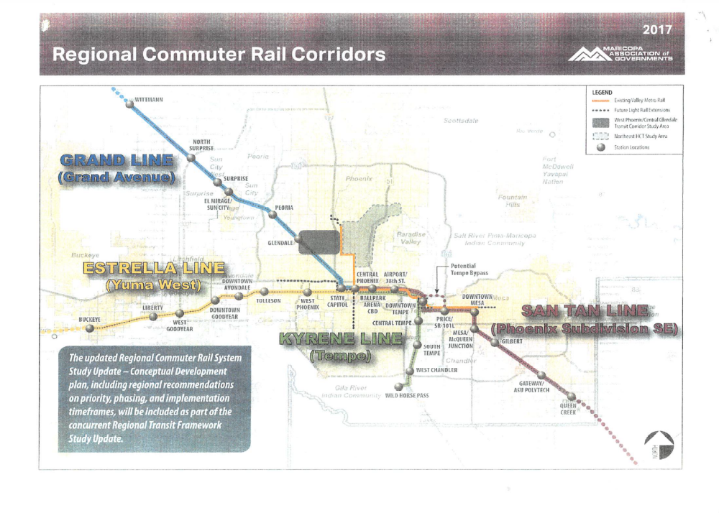
POSSIBLE MAG COMMUTER RAIL

Slide 6
MAG COMMUTER RAIL
MAG losing people to consulting firms.
Weak political leadership.
First quarter 2020 Policy Committee deadline to be missed; recipe for future election.
Was 2020, then 2022, now 2024.

Slide 7
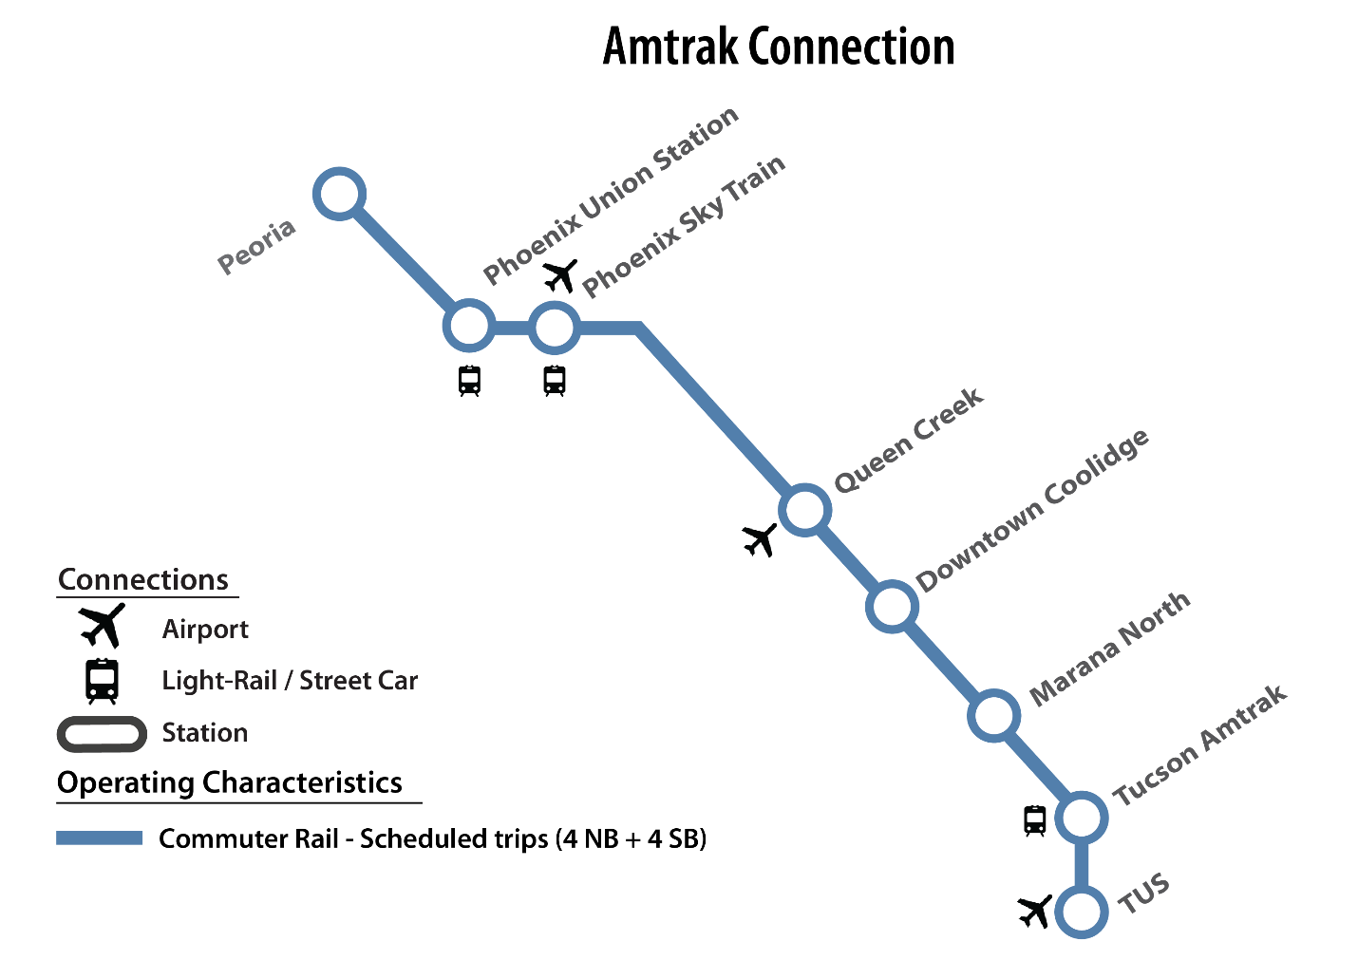
UNION PACIFIC ALTERNATIVE

Slide 8
ENTER AMTRAK
Amtrak meets with mayors of Yuma, Phoenix and Tucson to propose 1 round trip/day between Los Angeles and Tucson via Phoenix, and 3 round trips/day between Phoenix and Tucson.
Talked to UP? No.
Know about $500 million cost to re-open the West Line? Sort of.
What do we get if we write to Amtrak asking for this service? We conduct a 4- to 5-year feasibility study and then ask California and Arizona to pay for this service.
Are you aware that Arizona has no legal mechanism to support this service? No.
Have you talked to ADOT? No.
Have you talked to Gov. Ducey? No.
Conclusion: Jobs for the boys.

Slide 9
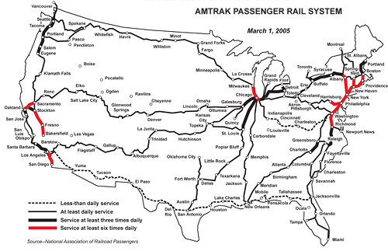
AMTRAK NATIONAL NETWORK

Slide 10
WITC
Amtrak to concentrate on Northeast Corridor and state-supported corridors of fewer than 750 miles. National network trains are not basic transportation and are “a relic of the past.” Ambus.
In April, we formed the Western Interstate Trains Coalition.
Put together video, sample letters to Congress, visual handouts.
Put together a team of activists drawn from RPA state representatives.
Mixed results.

Slide 11
WITC
1 RPA activist refused contact.
1 activist said he was too busy and passed the baton to another who refused contact.
3 activists agreed to participate but reneged.
7 activists became stars:
  Barry Green: Montana, Idaho, North Dakota;
  Deborah Fischer-Stout: Missouri, Kansas;
  Brian Nelson: Minnesota;
  Bob Kuzelka: Nebraska;
  Adrian Gurule: New Mexico;
  Gary Lanman: Oklahoma;
  Terry Brown: Wisconsin.

Slide 12
WITC
1 state organization provided initial funding but pulled out when the effort did not become self-sustaining.
1 state organization voted to fund but reneged.
The rest had no money.
RPA indicated that it could not provide funding.

Slide 13
ARIZONA EFFORTS
Yuma:
  Greater Yuma Economic Development Council;
  Yuma County Chamber of Commerce;
  City of Yuma;
  Yuma Metropolitan Planning Organization;
  Visit Yuma;
  Yuma Crossing National Heritage Areas;
  Yuma County Board of Supervisors;
  Yuma Sun.
Unqualified support for a daily Sunset Limited, continuation of Amtrak’s western interstate trains and new equipment and a commitment to write letters to the appropriate politicians.
Yuma has purchased the abandoned Hotel del Sol across the street from the train station and has applied for a BUILD grant to turn it into a multimodal transit center.

Slide 14
ARIZONA EFFORTS
Tucson:
  Tucson Department of Transportation;
  City of Tucson;
  Pima County;
  Visit Tucson.
Sen. McSally is not on board, while the two local congresspeople (Grijalva and Kirkpatrick) and Sen. Sinema are strong supporters.

Slide 15
ARIZONA EFFORTS
Chef Madison Butler came to town:
  Event at the Four Peaks Brewery in Tempe; five people from the Southwest Transit Memes for Desert-Oriented Teens; wide-ranging discussion of Amtrak, Arizona intercity rail, Phoenix area commuter rail, Valley Metro Rail and Proposition 105. There is a younger generation poised to take over advocacy. All we have to do is find and train them.
  Met with the manager and chef of Maynard’s Restaurant for some free samples and a discussion of the Amtrak situation.
  Farhad Moghimi, the Pima Association of Government’s transportation chief, hosted a tamale lunch at his conference room at PAG headquarters. We brought him and his guests up to date on Amtrak’s plans.
  Ken Karrels hosted a reception at the Southern Arizona Transportation Museum. Mayor Rothschild spoke, as did Madi, and I gave a rousing speech on what we had to do to prevent Amtrak from killing the national network.

Slide 16
ARIZONA EFFORTS
Flagstaff:
  City of Flagstaff;
  Discover Flagstaff.
Proper sense of alarm that Amtrak might attempt to eliminate the national network trains, especially the Southwest Chief, which is Flagstaff’s bread and butter.
Pertinent questions as to why we’ve come to this pass and what can be done about it, especially the airport and the federal money that could help it.
Letter under Mayor Coral Evans’ signature to congressional delegation about Amtrak and the local airport under the rubric “integrated transportation.”
Reporter for the Arizona Daily Sun, held a session after the meeting.

Slide 17
ARIZONA EFFORTS
Kingman:
  City of Kingman;
  Mohave County;
  Kingman Miner;
  Lake Havasu newspaper;
  Local radio station;
  Angry riders.
City Manager sent out 146 e-mail invitations to the meeting; 15 people responded; over 30 people showed up at the Kingman City Council chamber.
People were riled up about what Amtrak was proposing, and everyone from train riders to town officials agreed to contact Rep. O’Halleran and Sen. Sinema to thank them for their work to keep the trains. There was also agreement that Sen. McSally needed to hear from her constituents about this.

Slide 18
ARIZONA EFFORTS
Winslow:
  Town of Winslow;
  Winslow Chamber of Commerce;
  City of Flagstaff;
  Rep. Tom O’Halleran’s local office;
  Local radio station;
  Winslow Tribune;
  La Posada;
  Angry riders.
Town government wasn’t sure what to do about Amtrak, so punted to Bob Hall, Executive Director of Winslow Chamber of Commerce. Meeting called at Winslow Visitor Center, a former trading post. Over 40 people showed up.
City Councilwoman Samantha Crisp’s concern is local airport which was a major refueling stop in the early days of commercial aviation. It can handle large commercial jets. She is thinking in “intermodal” terms.
City Councilman Jim McCarthy drove in from Flagstaff along with Mayor Coral Evans, who wanted to borrow our logo and advertise Flagstaff at the first “All Aboard Arizona Community” in the state.
Chip Davis, the Northern District Director of Rep. O’Halleran’s office, made an appearance and assured the group of the congressman’s support of Amtrak.
Final result will be a resolution from the town government. The attendees will be writing letters of thanks to O’Halleran and Sinema, and letters asking McSally to support the trains.

Slide 19
AARP
Steve Jennings, Phoenix AARP representative, believes in Amtrak and passenger rail.
Sent link to video to DC headquarters where “it raised eyebrows.”
Jim Mathews of RPA had tried to get through to AARP in March 2017 and again this year. “AARP is a fortress.” Steve concurred.
Myrna Blyth of monthly magazine: “No. Drug pricing is Priority One.”
Frank Davies of weekly bulletin: “Send me info.”

Slide 20
?

